Slide 1
Microsoft Azure Practice Organization Demonstration
Zachary Hamade

Slide 2
Summary and Project Objectives
This project demonstrates the implementation of security and governance controls in Microsoft Azure aligned with the NIST Special Publication 800-53 Rev. 5 framework. The objective was to design and secure a cloud environment for a fictional organization while applying industry best practices for identity management, access control, configuration management, secrets management, auditing, and security monitoring.
The environment was deployed within a dedicated Azure Resource Group and included a virtual machine, storage account, Azure Key Vault, Microsoft Entra ID, Azure Policy, Microsoft Defender for Cloud, and Azure Monitor. Security controls were configured to enforce least privilege, governance, and operational security throughout the environment.
During implementation, Azure Role-Based Access Control (RBAC) was used to assign permissions based on user roles, while Microsoft Entra ID security groups were created to separate administrative and standard user responsibilities. Azure Policy was configured to restrict resource deployments to approved regions and require ownership tags for all resources, demonstrating preventive governance controls.
Azure Key Vault was deployed to securely store application secrets, eliminating the need to hardcode sensitive credentials. Microsoft Defender for Cloud was used to evaluate the security posture of the Azure subscription, and Azure Monitor Activity Logs provided an audit trail of administrative actions performed during deployment.
Several real-world challenges were encountered during implementation, including regional virtual machine deployment restrictions, Azure Policy enforcement preventing non-compliant resource creation, and Azure Key Vault RBAC configuration for data-plane access. Each issue was investigated and resolved, providing practical experience with Azure governance, identity management, and security operations.
This project demonstrates practical experience implementing Azure security controls that map directly to the NIST 800-53 control families, including Access Control (AC), Configuration Management (CM), Audit and Accountability (AU), System and Communications Protection (SC), Risk Assessment (RA), and System and Information Integrity (SI).
The following slides are screenshots of Azure features that assisted in completing this project.

Slide 3
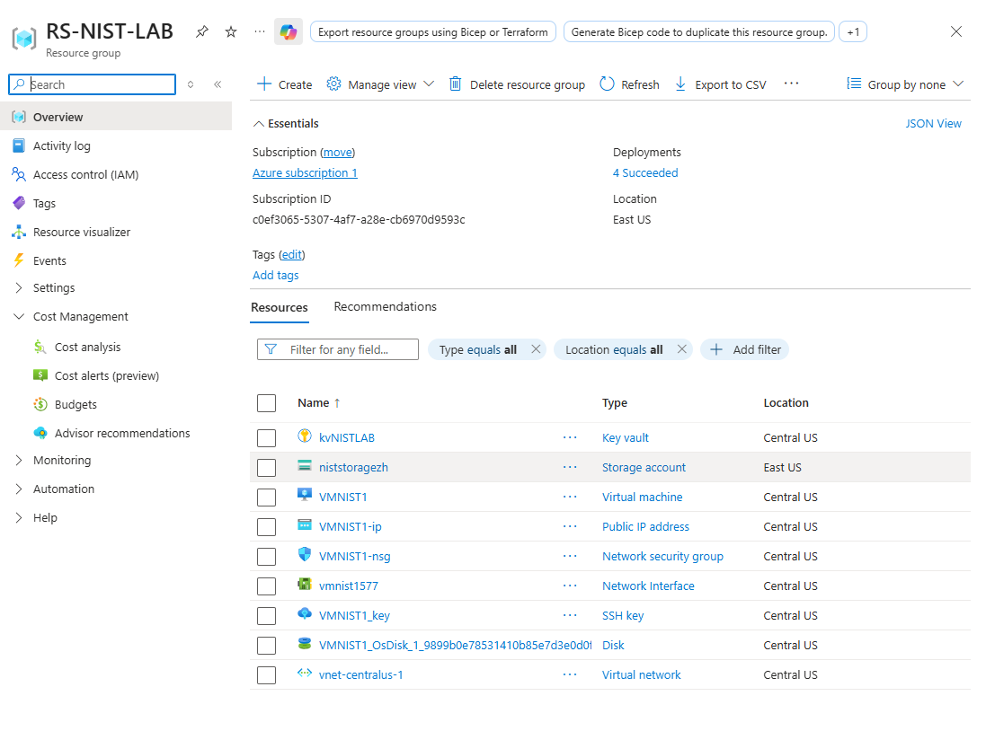
Resource Group

Slide 4
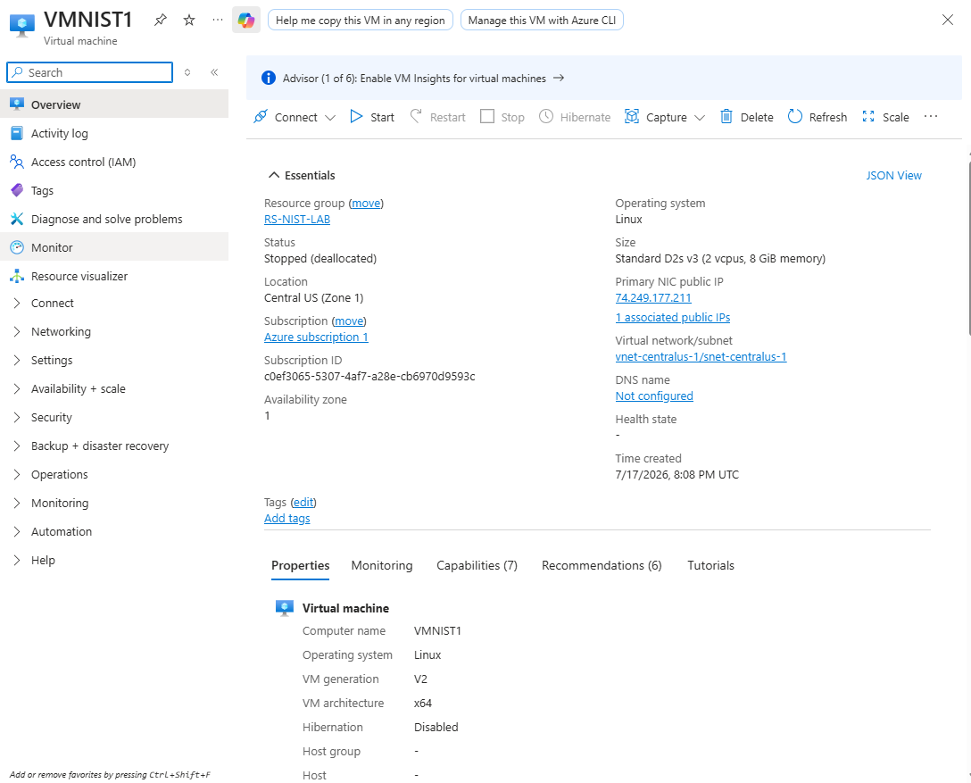
Virtual Machine

Slide 5
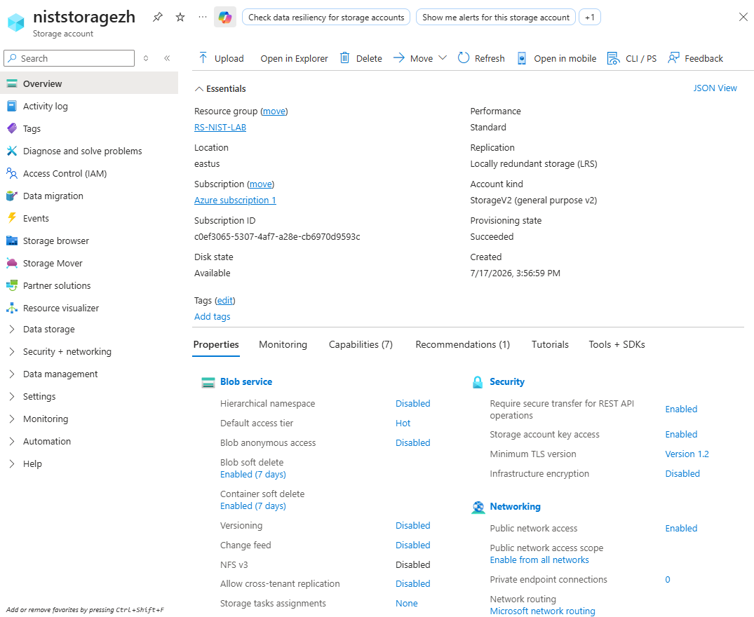
Storage Account

Slide 6
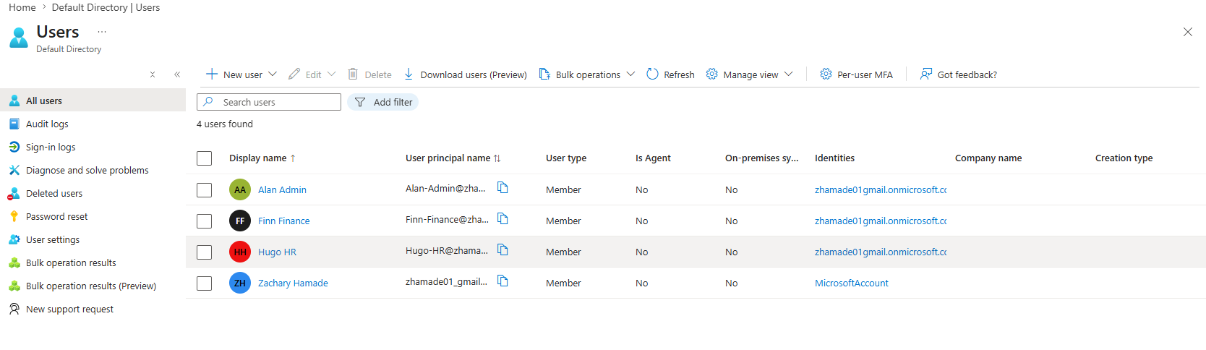
Microsoft Entra ID Users

Slide 7
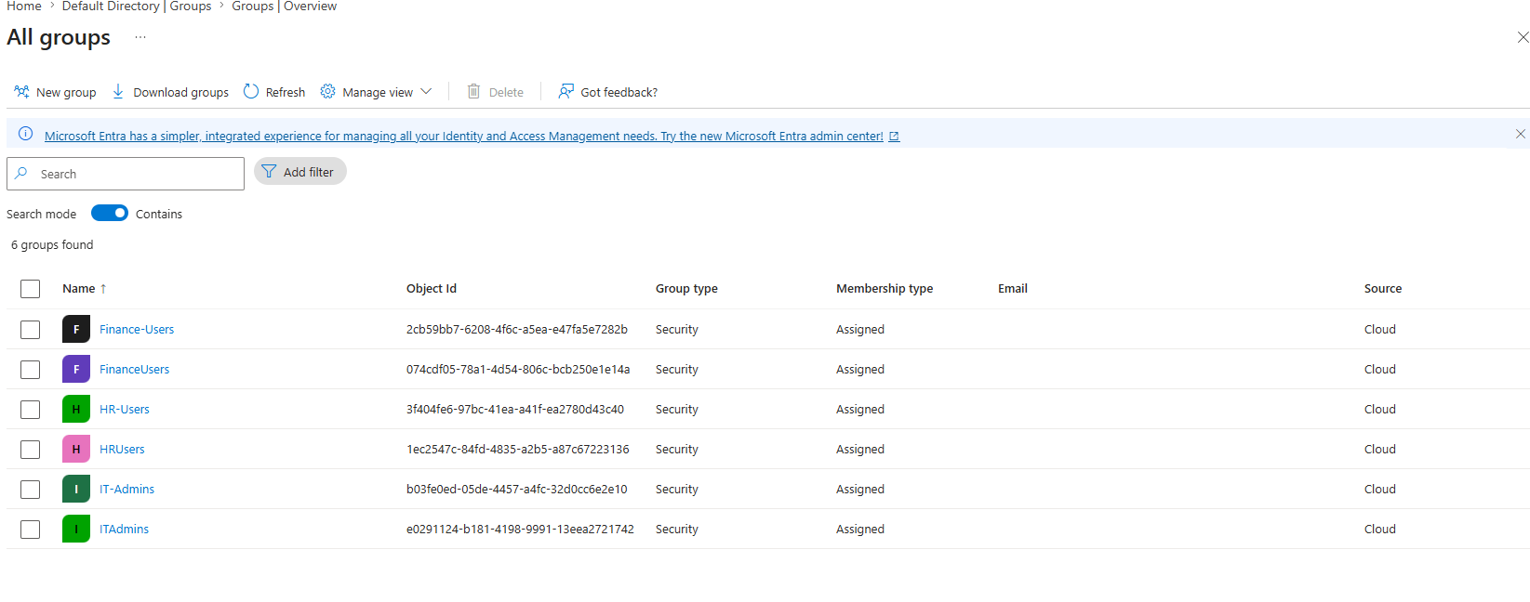
Microsoft Entra ID Groups
7

Slide 8
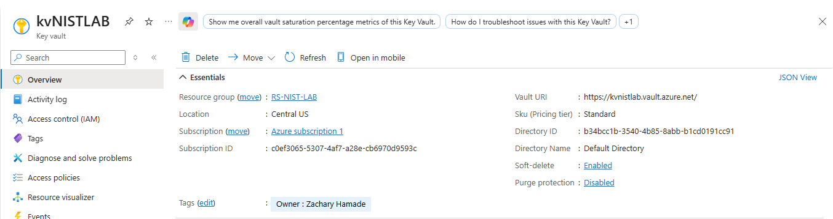
Key Vault Overview

Slide 9
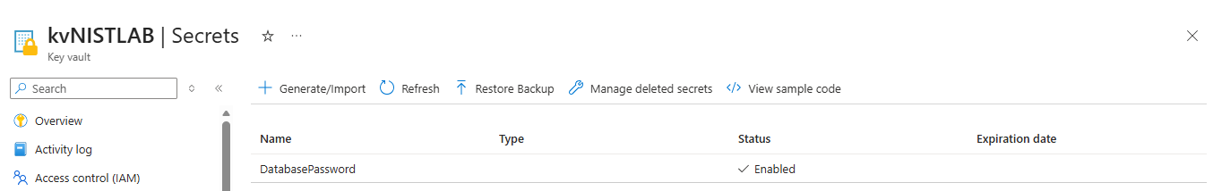
Key Vault Secret

Slide 10
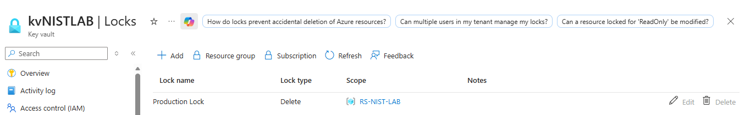
Resource Lock

Slide 11
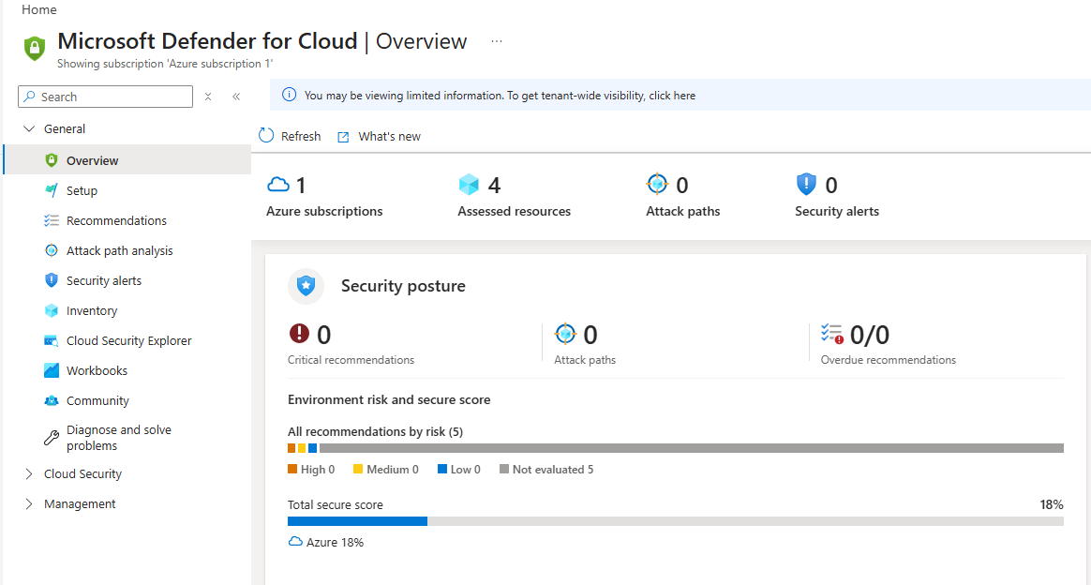
Microsoft Defender for Cloud
11

Slide 12
Architecture Diagram
Azure Subscription
NIST-LAB
Storage Account
Virtual Machine
Key Vault
Azure Monitor
Azure Policy
Allowed Locations
Require Owner Tag
Microsoft Entra ID
Security Groups
Azure RBAC
Test Users

Slide 13
Challenges Encountered and Remediation
VM Deployment Restrictions
VM deployment failed due to regional subscription limitations.
Resolution: Deployed the VM in a supported Azure region.
Conditional Access Licensing
Unable to configure Conditional Access and MFA using the Azure Free Trial.
Resolution: Documented the licensing requirement (Microsoft Entra ID Premium P1/P2) and implemented alternative security controls.
Azure Policy Enforcement
Azure Policy blocked Key Vault deployment because the required Owner tag was missing.
Resolution: Added the required tag to comply with governance policy.
Key Vault RBAC
Access to Key Vault secrets was denied due to missing data-plane permissions.
Resolution: Assigned the appropriate Key Vault RBAC role to enable secret management.

Slide 14
Lessons Learned
Azure resource availability varies by region and subscription type.
Microsoft Entra ID licensing directly impacts available security features.
Azure Policy provides preventive governance by enforcing organizational standards before deployment.
Azure RBAC and Key Vault demonstrate the importance of least-privilege access and separating management permissions from data access.
Microsoft Defender for Cloud and Azure Monitor provide visibility into security posture, compliance, and audit activity.
Successfully troubleshooting Azure deployments requires understanding governance, permissions, licensing, and platform limitations.

Slide 15
NIST 800-53 Controls Utilized
NIST Control | Azure Service | Evidence
AC-2 | Entra ID Users & Groups | Users and security groups
AC-3 | Azure RBAC | Role assignments
IA-2 | MFA | Requires Entra ID Premium P1
CM-2 | Azure Policy | Allowed Locations
CM-6 | Azure Policy | Require Owner Tag
CM-5 | Resource Locks | CanNotDelete lock
SC-12 | Azure Key Vault | Secret storage
AU-2 | Azure Monitor | Activity Log
AU-6 | Activity Log Review | Audit events
RA-5 | Defender for Cloud | Security posture
SI-2 | Defender for Cloud | Recommendations

Slide 16
Conclusion
This project demonstrated the practical implementation of Azure security controls aligned with the NIST SP 800-53 framework. By configuring identity and access management, governance policies, secure secrets management, auditing, and security monitoring, the environment was designed to reflect real-world cloud security best practices. Throughout the project, several deployment and configuration challenges were encountered and resolved, reinforcing the importance of troubleshooting, governance, and least-privilege principles. Overall, this project strengthened my understanding of Azure security services and their role in supporting compliance and securing cloud environments.

